Slide 1
PROOF OF STAKE
-- Lu Yu
The Holcombe Department of Electrical & Computer Engineering

Slide 2
Proof of Stake (PoS)
Proof of Stack (PoS) is a class of consensus algorithms.

Slide 3
Proof of Stake (PoS)
Proof of Stack (PoS) is a class of consensus algorithms.
A group of validators “take turns” proposing and vote on the next block.

Slide 4
Proof of Stake (PoS)
Proof of Stack (PoS) is a class of consensus algorithms.
A group of validators “take turns” proposing and vote on the next block.
Anyone who possesses the blockchain’s base cryptocurrency can become a validator.
To become a validator, you need to make a deposit by sending a special type of transaction.

Slide 5
Proof of Stake (PoS)
Proof of Stack (PoS) is a class of consensus algorithms.
A group of validators “take turns” proposing and vote on the next block.
Anyone who possesses the blockchain’s base cryptocurrency can become a validator.
To become a validator, you need to make a deposit by sending a special type of transaction.
The weight of a validator’s vote depends on the size of its deposit.

Slide 6
Proof of Stake (PoS)
Proof of Stack (PoS) is a class of consensus algorithms.
A group of validators “take turns” proposing and vote on the next block.
Anyone who possesses the blockchain’s base cryptocurrency can become a validator.
To become a validator, you need to make a deposit by sending a special type of transaction.
Two major types of PoS algorithm:
Chain-based PoS
BFT-based PoS

Slide 7
Chain-Based PoS
Steps:
“Randomly” select a validator during each time slot.
The selected validator creates a block.
The block points a previous block (Normally the last block of the longest chain).
Most blocks will converge into a single chain.

Slide 8
BFT-Based PoS
Steps:
Validators are “randomly” assigned the right to propose blocks.
Every validator sends a vote for some specific block.
Repeat Step 1&2 multiple times.
At the end, all (honest and online) validators agree on if a given block is part of the chain.
What is BFT?
Byzantine Generals Problem
What is pBFT?

Slide 9
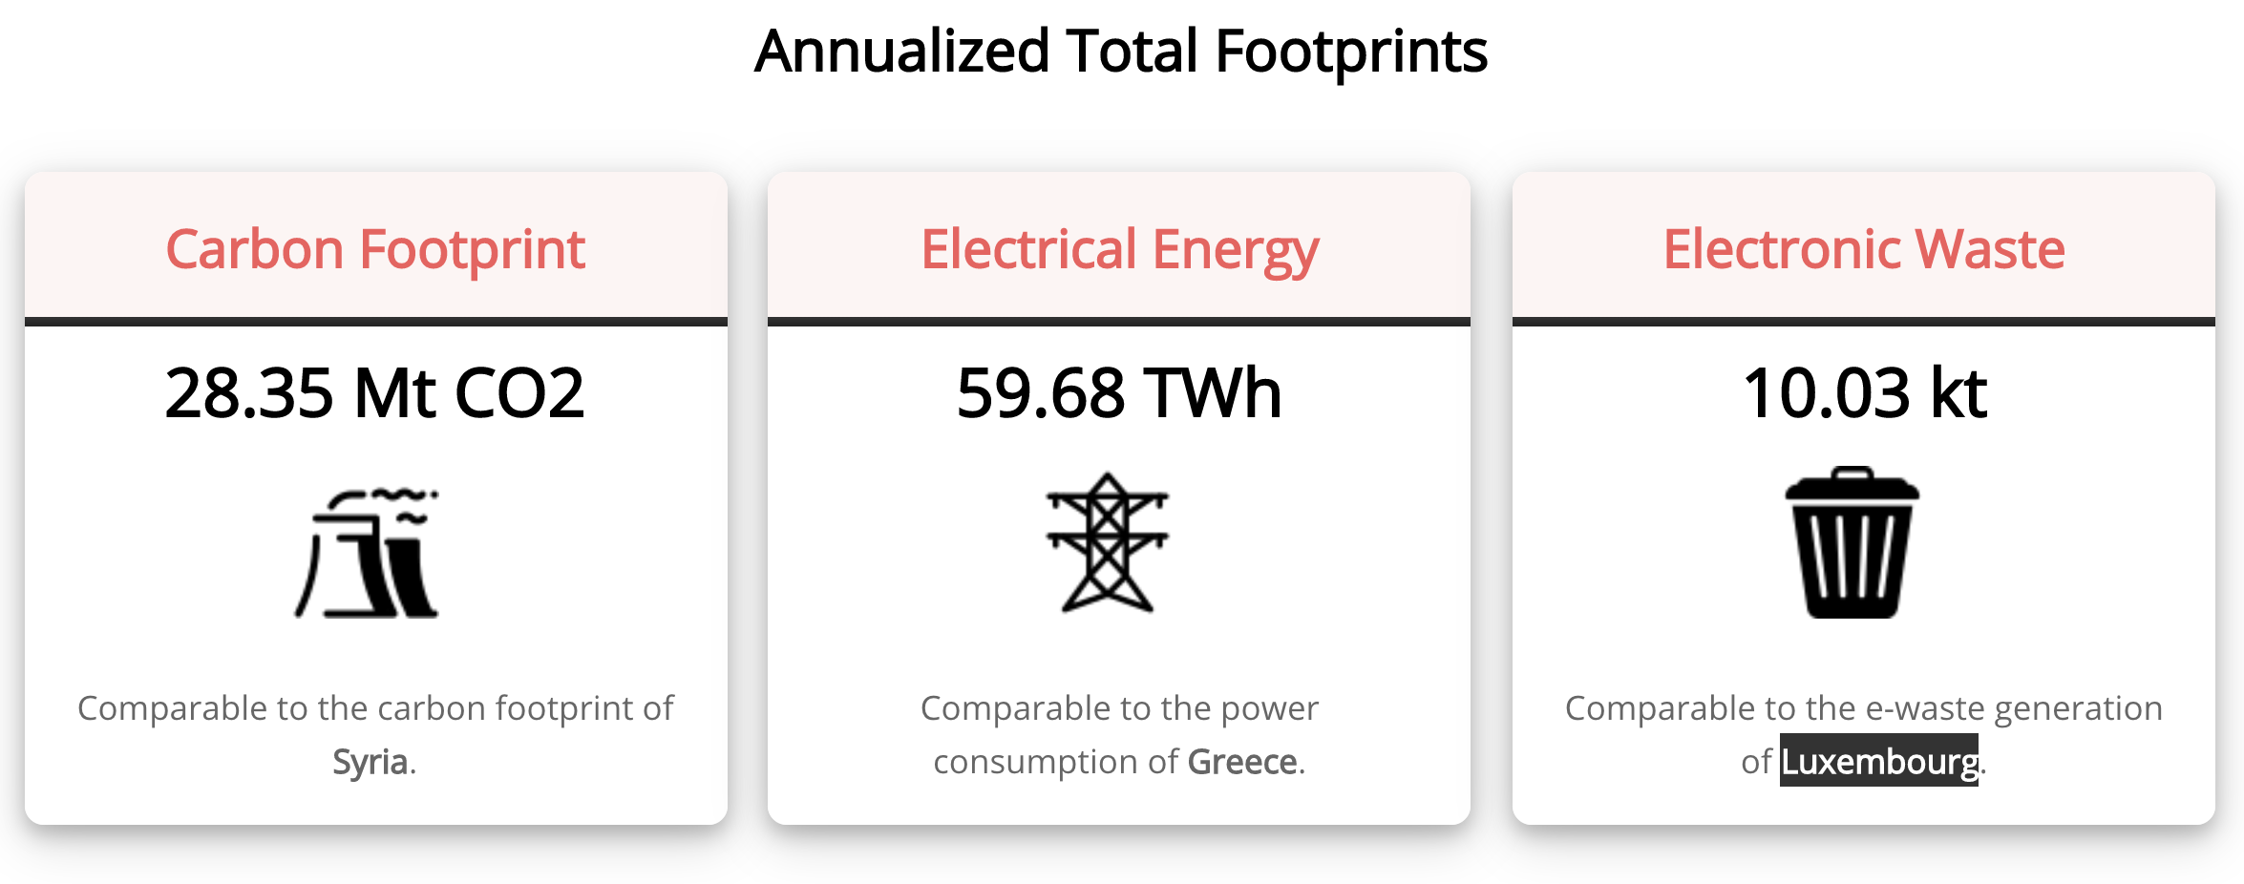
Benefits of PoS
Compared with PoW:
Does not consume a huge amount of electricity.
https://digiconomist.net/bitcoin-energy-consumption

Slide 10
Benefits of PoS
Compared with PoW:
Does not consume a huge amount of electricity.
No need to issue as many new coins as PoW.
Because PoW consumes large amount of power, it needs more coins to motivate miners.
https://medium.com/@VitalikButerin/a-proof-of-stake-design-philosophy-506585978d51

Slide 11
Benefits of PoS
Compared with PoW:
Does not consume a huge amount of electricity.
No need to issue as many new coins as PoW.
Because PoW consumes large amount of power, it needs more coins to motivate miners.
Reduced risk of centralization.
You get what you “paid for”.
No incentive to join a mining pool.
https://medium.com/@VitalikButerin/a-proof-of-stake-design-philosophy-506585978d51

Slide 12
https://blockchain.info/pools

Slide 13
Benefits of PoS
Compared with PoW:
Does not consume a huge amount of electricity.
No need to issue as many new coins as PoW.
Because PoW consumes large amount of power, it needs more coins to motivate miners.
Reduced risk of centralization.
You get what you “paid for”.
No incentive to join a mining pool.
Less 51% attacks.
The expensive economic penalties make attacks less likely.
https://medium.com/@VitalikButerin/a-proof-of-stake-design-philosophy-506585978d51

Slide 14
Results of BFT
BFT applies to PoS algorithms and PoW.

Slide 15
Results of BFT
BFT applies to PoS algorithms and PoW.
CAP theorem: A distributed system can only provide at most than two out of the three desired characteristics: availability, consistency, and partition tolerance.

Slide 16
Results of BFT
BFT applies to PoS algorithms and PoW.
CAP theorem: A distributed system can only provide at most than two out of the three desired characteristics: availability, consistency, and partition tolerance.
FLP impossibility: In a fully asynchronous system, no algorithm can guarantee a consensus reached in any finite amount of time, even if there is only one faulty node.
The network is a fully asynchronous system...

Slide 17
Results of BFT
BFT applies to PoS algorithms and PoW.
CAP theorem: A distributed system can only provide at most than two out of the three desired characteristics: availability, consistency, and partition tolerance.
FLP impossibility: In a fully asynchronous system, no algorithm can guarantee a consensus reached in any finite amount of time, even if there is only one faulty node.
The network is a fully asynchronous system...
Bounds on fault tolerance:
A partially asynchronous system tolerates up to 1/3 faulty nodes.
Deterministic protocols in fully asynchronous system cannot tolerate any fault.
A synchronous system tolerates up to 100% faulty nodes.

Slide 18
BFT of PoW
PoW is a consensus algorithm relying on a synchronous network model.
https://socrates1024.s3.amazonaws.com/consensus.pdf

Slide 19
BFT of PoW
PoW is a consensus algorithm relying on a synchronous network model.
System model:
An infinite number of nodes
Each node has a small amount of computing power and therefore has a small probability of creating the next block in a given period.
https://socrates1024.s3.amazonaws.com/consensus.pdf

Slide 20
BFT of PoW
PoW is a consensus algorithm relying on a synchronous network model.
System model:
An infinite number of nodes
Each node has a small amount of computing power and therefore has a small probability of creating the next block in a given period.
BFT results:
Tolerate up to 50% faulty nodes with zero network latency.
Simulation results are 46% faulty nodes for Ethereum and 49.5% faulty nodes for Bitcoin.
33% if the network latency is equal to the block time.
https://socrates1024.s3.amazonaws.com/consensus.pdf

Slide 21
BFT of PoS
Synchronous network model
Chain-based PoS algorithms always rely on synchronous network model.
Proof is similar to PoW.
https://socrates1024.s3.amazonaws.com/consensus.pdf

Slide 22
BFT of PoS
Synchronous network model
Chain-based PoS algorithms always rely on synchronous network model.
Proof is similar to PoW.
Partially synchronous network model
A lot more complex
https://socrates1024.s3.amazonaws.com/consensus.pdf

Slide 23
CAP Theorem & PoW/PoS
For PoW and chain-based PoS:
Availability > Consistency

Slide 24
CAP Theorem & PoW/PoS
For PoW and chain-based PoS:
Availability > Consistency
Traditional BFT consensus algorithms:
Availability < Consistency

Slide 25
CAP Theorem & PoW/PoS
For PoW and chain-based PoS:
Availability > Consistency
Traditional BFT consensus algorithms:
Availability < Consistency
Casper:
Availability > Consistency

Slide 26
CAP Theorem & PoW/PoS
For PoW and chain-based PoS:
Availability > Consistency
Traditional BFT consensus algorithms:
Availability < Consistency
Casper:
Availability > Consistency
Note: Most of the upper bounds on the number of fault nodes that can be tolerated are theoretical values.
In traditional BFT consensus algorithms, nodes are machines.
Psychological factors need to be considered.
https://bitcoinmagazine.com/articles/selfish-mining-a-25-attack-against-the-bitcoin-network-1383578440

Slide 27
Reference
Ethereum Wiki, “Proof of Stake FAQs”. Available at: https://eth.wiki/en/concepts/proof-of-stake-faqs
https://blog.cosmos.network/consensus-compare-casper-vs-tendermint-6df154ad56ae
Juin Chiu, “Casper FFG: Consensus Protocol for the Realization of Proof-of-Stake”. Available at: https://medium.com/unitychain/intro-to-casper-ffg-9ed944d98b2d
Juin Chiu, “Introduction to PBFT”. Available at: https://medium.com/unitychain/if-you-really-want-to-make-sense-of-blockchain-you-cannot-ignore-the-classics-an-introduction-to-3c72dc8c5515

